Slide 1
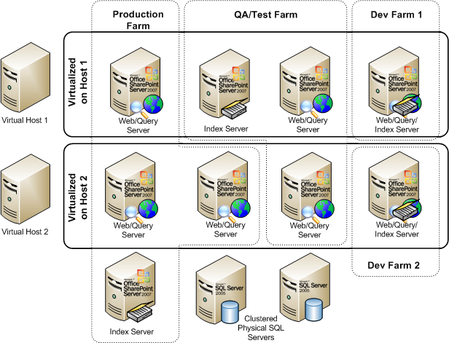

Building the ‘Perfect’ SharePoint Farm
Michael Noel
Convergent Computing
Twitter: @michaelTnoel
Egypt SharePoint User Group
Cairo, Egypt
14 June, 2009

Slide 2
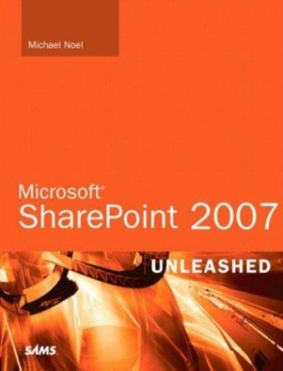
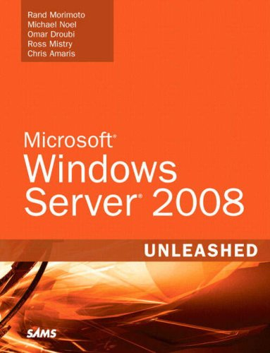
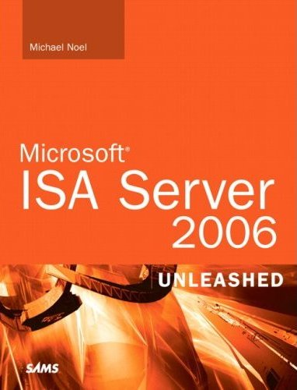
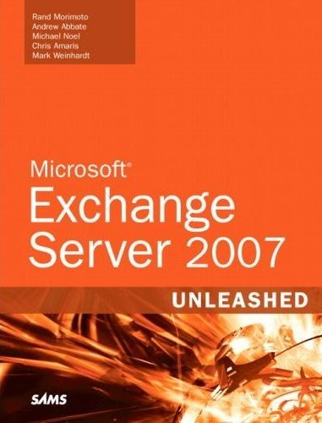
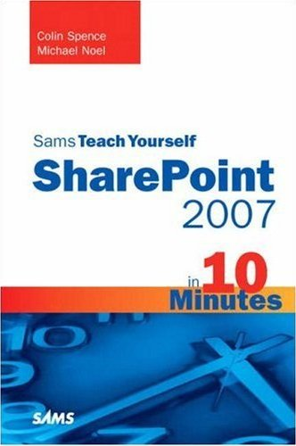
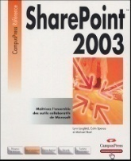
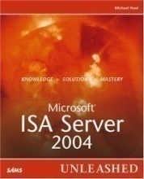
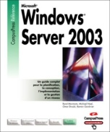
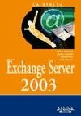
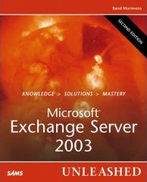
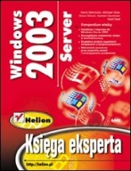
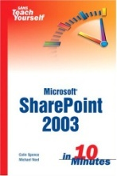
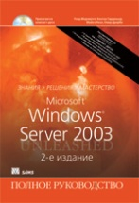
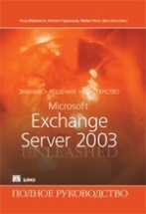
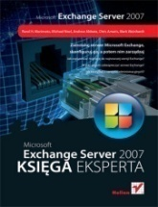
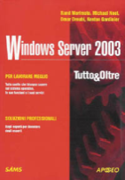
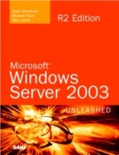
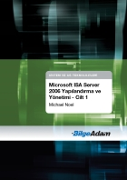
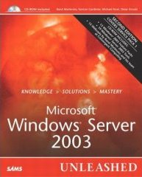
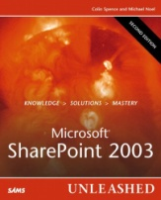
Michael Noel
Author of SAMS Publishing titles “SharePoint 2007 Unleashed,” the upcoming “Teach Yourself SharePoint 2007 in 10 Minutes,” “SharePoint 2003 Unleashed”, “Teach Yourself SharePoint 2003 in 10 Minutes,” “Windows Server 2008 Unleashed,” “Exchange Server 2007 Unleashed”, “ISA Server 2006 Unleashed”, and many other titles .
Partner at Convergent Computing (www.cco.com / +1(510)444-5700) – San Francisco, U.S.A. based Infrastructure/Security specialists for SharePoint, AD, Exchange, Security

Slide 3
Session Objectives And Agenda
Examine various SharePoint farm architecture best practices that have developed over the years
Examine SharePoint Best Practice Farm Architecture
Understand SharePoint Virtualization Options
Explore SharePoint DR and HA strategies using Database Mirroring
Learn how to Enable Kerberos for Best Practice Security
A large amount of best practices covered (i.e. Drinking through a fire hose), expectation is that you can take away 2-3 useful pieces of information that can be used in your environment

Slide 4
Architecting the Farm
Various SharePoint Designs
Notes:
4

Slide 5

Farm Architecture
All-in-One Farm
All SharePoint roles and SQL Server on the same box
For very small environment without a lot of load
SQL contention with SharePoint
Easy to deploy, but highest potential for contention
NOTE: Only test environments use SQL Server Express or SQL Embedded

Slide 6


Farm Architecture
Dedicated SQL Database Server
Dedicated SQL Server
All SharePoint roles on single box
Disk IO contention lessened by moving SQL off SP Server
Greater performance can be gained by breaking SharePoint roles onto separate servers

Slide 7
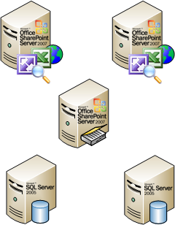
Farm Architecture
Smallest Highly-Available Farm
2 Web/Query/Excel Services/Central Admin/Inbound Email Servers
1 Dedicated Index Server (With Web role to allow it to crawl content as dedicated crawl server)
2 SQL Standard Edition Cluster Nodes
Smallest highly available farm (loss of any one server will not affect functionality)

Slide 8
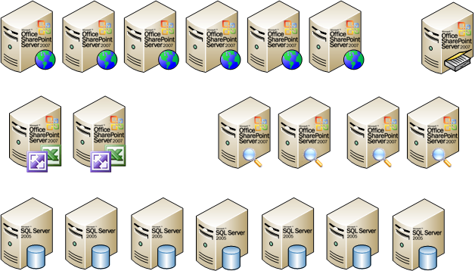
Farm Architecture
Scalable Farm
Multiple Dedicated Web Role Servers
Multiple Dedicated Query Servers
Multiple Dedicated Application Servers
Dedicated SharePoint Central Admin Server(s)
Single Index Server (per Shared Services Provider)
Multiple node or multiple instance SQL Server Enterprise Edition Cluster(s)

Slide 9
Virtualized Farm Architecture
Taking Advantage of Virtualization for SharePoint
Notes:
9

Slide 10
Virtualized Farm Architecture
Virtualization of SharePoint as a Good Thing
Virtualization of SharePoint is supported and recommended in many cases.
Not all roles are the best candidates for virtualization, depending on the level of disk I/O that is expected. The best candidate for virtualization is the Web/Frontend, followed by Query, Application, Index, and finally SQL.
Windows Server 2008 Hyper-V is an excellent option, and can save money, Upcoming R2 Version includes free Live Migration.
Microsoft supports third party if they are a member of the SVVP (KB 897615), this includes VMware and Citrix XenServer. There are some limitations, consult the KB article

Slide 11
Virtualized Farm Architecture
Microsoft Virtualization Licensing
Windows Server Virtualization Licensing
  Standard Edition: One virtual guest (if host is dedicated to virtualization role)
  Enterprise Edition: Four virtual guests (if host is dedicated to virtualization role) / Guests can be Std/Ent
  DataCenter Edition: Unlimited Number of Virtual Guests / Per processor socket license
  Virtualization OS licensing applies to Hyper-V or any virtual host software listed in SVVP (KB 897615)
System Center Virtualization Licensing
  System Center Management Suite Standard Edition License: Gives DPM, OpsMgr, ConfigMgr, and VMM Agents for 1 server.
  System Center Management Suite Enterprise Edition License: Gives unlimited DPM, OpsMgr, ConfigMgr, and VMM Agents for all virtual guests on the host.
Check with Microsoft for Specifics…

Slide 12
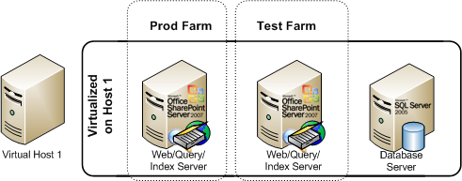
Virtualized Farm Architecture
Cost-effective Virtual Environment
Allows organizations that wouldn’t normally be able to have a test environment to run one
Allows for separation of the database role onto a dedicated server
Can be more easily scaled out in the future

Slide 13
Virtualized Farm Architecture
Fully Redundant Farm with only Two Servers
High-Availability across Hosts
All components virtualized
Uses only two Windows Ent Edition Licenses
With Vmotion, XenMotion, or Hyper-V R2 Live Migration, failover can be setup at VM level

Slide 14
Virtualized Farm Architecture
Best Practice Virtual/Physical Farm with HA and Performance
Highest transaction servers are physical
Multiple farm support, with DBs for all farms on the SQL cluster
Only five physical servers total, but high performance

Slide 15
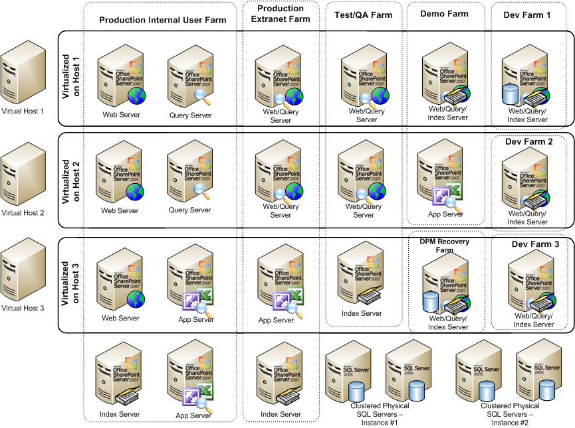
Multiple Hosts – Scale Out

Slide 16
Content Database and Site Collection Architecture
Distribute by Default
Notes:
16

Slide 17
Content Database and Site Collection Planning
Distribute by Default
Start with a distributed architecture of content databases from the beginning, within reason (more than 50 per SQL instance is not recommended)
Distribute content across Site Collections from the beginning as well, it is very difficult to extract content after the face
Allow your environment to scale and your users to ‘grow into’ their SharePoint site collections

Slide 18
Sample SP Logical Architecture

Slide 19
Content Database Mirroring
Using SQL 2005/2008 Mirroring for SharePoint Content Databases
Notes:
19

Slide 20
SQL Database Mirroring
HA Solutions using Mirrored Copies of SharePoint Databases
New in SQL 2005, available in both Standard and Enterprise editions, improved in SQL 2008
Works by keeping a mirror copy of a database or databases on two servers
Can be used locally, or the mirror can be remote
Can be set to use a two-phase commit process to ensure integrity of data across both servers
Can be combined with traditional shared storage clustering to further improve redundancy

Slide 21
SQL Database Mirroring
SQL Mirroring Modes
High Performance (Enterprise Edition only)
  Asynchronous Mirroring
  Safety level = OFF
  Failure of principal server may result in data loss
High Availability
  Synchronous Mirroring
  Safety level = ON
  Dual-commit process ensures no data loss
  Third witness server required
High Protection
  Synchronous Mirroring
  Safety level = ON
  Manual failover, no witness server

Slide 22
SQL Mirroring Designs
Various SharePoint Mirrored DB Options
Single Site HA Mirrored Farm
  Synchronous Replication
  All Servers in one Physical Location
Cross Site Mirrored HA Farm
  Synchronous Replication
  Servers split across highly connected physical sites
Two Farm / Mirrored Content DBs
  Asynchronous Replication
  Content Databases Mirrored Only
  Manual Failover Process

Slide 23
Single Site HA Mirrored Farm
Single Site
Synchronous Replication
Uses a SQL Witness Server to Failover Automatically
Mirror all SharePoint DBs in the Farm
Use a SQL Alias to switch to Mirror Instance

Slide 24
Cross-Site Mirrored HA Farm
Two Sites
1 ms Latency
1Gb Bandwidth
Farm Servers in each location
Auto Failover

Slide 25
Two Farm / Mirrored Content DBs
Two Sites
Two Farms
Mirror only Content DBs
Failover is Manual
Must Re-index
Mirroring or Log Shipping (More details…)

Slide 26
Hardware / Software
Planning for the farm
Notes:
26

Slide 27
Hardware Planning Considerations
Disk, Memory, and Processor
SQL Database role requires a great deal of space, especially if versioning is turned on in Document Libraries. Don’t underestimate!
Index and Query servers also need hard drive space to store the Index files, which can be 5%-30% of the size of the items being indexed.
The more memory and processor cores that can be given to SharePoint the better, in the following priority:
  Database Role
  Index Role
  Web/Query Role

Slide 28
Operating System Best practices
Versions
Highly recommended: Windows Server 2008 for security, performance (client/server traffic improvements), and ease of setup
x64 bit also very highly recommended (Next version of SharePoint is x64 bit only.
Enterprise Edition of Windows only required for very large SQL instances (More than two cluster nodes, high transaction volume, etc.) Standard edition of Windows is adequate in nearly all other cases.

Slide 29
Operating System Best practices
SQL Server
SQL Server 2008 Recommended, particularly if you have high security requirements, as it allows for transparent encryption of databases
SQL Server 2005 also fully supported
Enterprise edition of SQL only required for more than two nodes in a cluster, Asynchronous database mirror replication, and/or greater than 32GB RAM
Separate Reporting Services server may be required for intensive reporting

Slide 30
SharePoint Installation
Adding the SharePoint binaries
Notes:
30

Slide 31
SharePoint Installation
Service Accounts
Never use a single account for all services unless it’s a test farm.
At a minimum, create the following accounts:
  SQL Admin Account
  Installation Account (Local admin rights on SP servers)
  SharePoint Farm Admin (Requires SQL DBCreator and SQL Security Admin on SQL box)
  Search Admin (Requires local admin rights on any Query or Index servers
  Default Content Access Account (Read-only access to all indexed locations)
  Application Pool Identity Account (at least one, can use multiple for each App pool.) It is critical for security that this isn’t the farm admin account.

Slide 32
SharePoint Installation
Installation Process
For most flexibility, choose ‘Complete’ Installation, even if not installing all of the roles on the server. This will allow for the addition of roles in the future as needed.
Be sure not to select ‘Stand-Alone’, unless you plan on having a very small farm with a limited database (SQL Server Express)

Slide 33
SharePoint Installation
Installation Process
Highly recommended to choose the final destination for the Index/Query to live (i.e. if it’s on a different drive, enter that during installation). It’s difficult to change index location later.
Remember, after installing the binaries, the server is not a farm member yet…it can be added to any farm. Good concept to use to pre-stage servers.

Slide 34
SharePoint Installation
Command-line Installation of SharePoint
Good to understand how to install SharePoint from the command-line, especially if setting up multiple servers.
Allows for options not available in the GUI, such as the option to rename the Central Admin Database to something easier to understand.
Use SETUP, PSCONFIG and STSADM to script the install process, check online blogs for details.

Slide 35
Creating A Farm
Using the Configuration Wizard or PSCONFIG
Notes:
35

Slide 36
Creating the Farm
Running the Config Wizard to Install Servers
Consider using an easy to remember port for the Central Admin service (i.e. 8888)
You are welcome to change the Config Database name to match a common naming convention
Your database access account is the SP Service account, which only needs DBCreator and Security Admin rights on SQL. Don’t give it more!
Run the wizard on additional servers as necessary

Slide 37
Creating the Farm
Using a SQL Alias
Do yourself a HUGE favor and don’t forget to use a DNS Alias and/or SQL Alias when creating the SQL Config Database. For example, if your SQL server name is ‘SQLSERVER1’, use something like ‘SPSQL’ to connect, and have DNS point to the proper server location. This makes it MUCH more flexible.
Can use SQL Client tools on SP Servers to allow SQL Aliases to be quickly changed

Slide 38
Creating the Farm
Network Load Balancing
Hardware Based Load Balancing (F5, Cisco, Citrix NetScaler – Best performance and scalability
Software Windows Network Load Balancing fully supported
Best Practice – Create Multiple Web Apps with Load-balanced VIPs (Sample below)
  Web Role Servers
    sp1.companyabc.com (10.0.0.101) – Web Role Server #1
    sp2.companyabc.com (10.0.0.102) – Web Role Server #2
  Clustered VIPs shared between SP1 and SP2 (Create A records in DNS)
    spnlb.companyabc.com (10.0.0.103) - Cluster
    spca.companyabc.com (10.0.0.104) – SP Central Admin - Config info later…
    ssp1.companyabc.com (10.0.0.105) – Shared Services Provider
    spsmtp.companyabc.com (10.0.0.106) – Inbound Email VIP
    home.companyabc.com (10.0.0.107) – Main SP Web App (can be multiple)
    mysite.companyabc.com (10.0.0.108) – Main MySites Web App

Slide 39
Kerberos
Security for a modern SharePoint environment
Notes:
39

Slide 40
Kerberos
Best practice: Enable Kerberos!
When creating any Web Applications for Content, USE KERBEROS. It is much more secure and also faster with heavy loads as the SP server doesn’t have to keep asking for auth requests from AD.
Kerberos auth does require extra steps, which makes people shy away from it, but once configured, it improves security considerably and can improve performance on high-load sites.

Slide 41
Kerberos
Step 1: Create the Service Principal Names
Use the setspn utility to create Service Principle Names in AD, the following syntax for example:
  Setspn.exe -A HTTP/mysite.companyabc.com DOMAINNAME\MYSiteAppAccount
  Setspn.exe -A HTTP/mysite DOMAINNAME\MYSITEAppAccount
  Setspn.exe -A HTTP/home.companyabc.com DOMAINNAME\HOMEAppAccount
  Setspn.exe -A HTTP/sp DOMAINNAME\HOMEAppAccount

Slide 42
Kerberos
Step 2: Enable Kerberos from SP Servers to SQL
Use setspn to create SPNs for SQL Service Account
SPNs need to match the name that SharePoint uses to connect to SQL (Ideally SQL Alias, more on this later)
Syntax similar to following:
  Setspn.exe -A MSSQLSvc/spsql:1433 COMPANYABC\SRV-SQL-DB
  Setspn.exe –A MSSQLSvc/spsql.companyabc.com:1433 COMPANYABC\SRV-SQL-DB
MSSQLSvc = Default instance, if named instance, specify the name instead
In this example, SRV-SQL-DB is the SQL Admin account

Slide 43
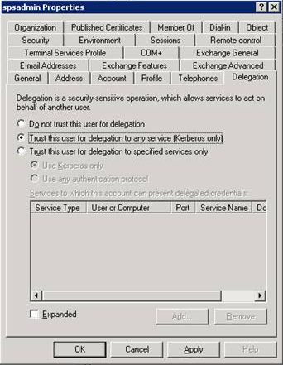
Kerberos
Step 3: Allow User and Computer Accounts to Delegate
Required for Excel Services and other impersonation applications.
On all SP Computer accounts and on the Application Identity accounts, check the box in ADUC to allow for delegation.
  In ADUC, navigate to the computer or user account, right-click and choose Properties.
  Go to the Delegation tab
  Choose Trust this user/computer for delegation to any service (Kerberos)

Slide 44
Kerberos
Step 4 (Windows 2008 only): Edit ApplicationHost.config file
Windows Server 2008 front-ends requires the \Windows\System32\inetsrv\config\ApplicationHost.config file to be modified to contain the following string for each Kerberos Web App:
  <windowsAuthentication enabled="true" useKernelMode="true" useAppPoolCredentials="true">

Slide 45
Kerberos
Step 5: Enable Kerberos on Web Application
Go to Application Management – Authentication Providers
Choose the appropriate Web Application
Click on the link for ‘Default’ under Zone
Change to Integrated Windows Authentication - Kerberos (Negotiate)
Run iisreset /noforce from the command prompt
If creating Web App from scratch, this step may be unnecessary if you choose Negotiate from the beginning

Slide 46
Kerberos
Bonuses for SPCA and SSP – Kerberos,NLB, SSL, and Default Port
Bonus #1: Enable Kerberos
  Add the SPNs for SPCA and SSP
    HTTP/spca.companyabc.com, HTTP/spca (Add to Farm Admin account)
    HTTP/ssp1.companyabc.com, HTTP/ssp1 (Add to SSP App Pool Identity account)
  Configure Kerberos as defined in this presentation
  SSP requires extra steps
    Install Infrastructure Update (KB951695) or SP2
    Create Registry Key “HKLM\Software\Microsoft\Office Server\12.0\KerberosSpnFormat” (REG_DWORD) = 1
    Create SPNs for each Web Role Server that hosts SSP (example below, SSP1 = name of SSP, sp1 = SharePoint server)
      MSSP/sp1:56737/SSP1
      MSSP/sp1:56738/SSP1
    Enable Kerberos from the command prompt (Stsadm.exe -o SetSharedWebServiceAuthn-negotiate)
Bonus #2: Configure both for SSL
  Encrypts traffic and Admin passwords
  Create and install Web certs for spca.companyabc.com, ssp1.companyabc.com
Bonus #3: Load Balance SPCA and SSP
  Install SPCA on multiple web role servers
  Enable either Hardware NLB or Software Windows Network Load Balancing
  Requires DNS A record (spca.companyabc.com), registry key and AAM modification (below)
Bonus #4: Setup SPCA on port 443/80
  Delete default IIS Web Site
  Assign dedicated IP (VIP if load balancing) to SPCA Web App
  Run STSADM to change the port(s)
    stsadm –o setadminport –port 80
    stsadm –o setadminport –ssl –port 443
  Change Port to 80 and 443 in IIS, Assign Cert (if using SSL)
  Modify SPCA URL on SP Servers - “HKLM\SOFTWARE\Microsoft\Shared Tools\Web Server Extensions\12.0\WSS\CentralAdministrationURL” (REG_SZ) = https://spca.companyabc.com/
  Change your default AAM to https://spca.companyabc.com

Slide 47
Key Takeaways
Use multiple service accounts, definitely don’t mix Application Pool identity accounts with the farm admin accounts
Use Kerberos when at all possible
Use a SQL DB Alias for greatest flexibility with a SP Farm
Consider DB Mirroring as a DR option
A five server farm is the smallest that is highly available
One last best practice – Don’t forget Antivirus and Backup

Slide 48
For More Information
SharePoint 2007 Unleashed and Teach Yourself SharePoint 2007 in 10 Minutes (http://www.samspublishing.com)
Microsoft ‘Virtualizing SharePoint Infrastructure’ Whitepaper (http://tinyurl.com/virtualsp )
Microsoft SharePoint SQL DB Mirroring Whitepaper (http://tinyurl.com/mirrorsp)
Microsoft Guidance on SQL Log Shipping for SharePoint (http://tinyurl.com/logshipsp)
Microsoft Guidance on Kerberos (http://tinyurl.com/kerbsp)
Thanks for attending!
Michael Noel
Twitter: @MichaelTNoel
www.cco.com

Slide 49

Thanks for having me at your user group in Egypt!
Questions?
Michael Noel
Twitter: @michaelTnoel
www.cco.com

